Slide 1
The role of abstraction in compositionality in human and artificial neural networks

Slide 2
Objective
How do brains represent compositionality?
Can compositional representations in brains inform how to learn compositional representations in ANNs?

Slide 3
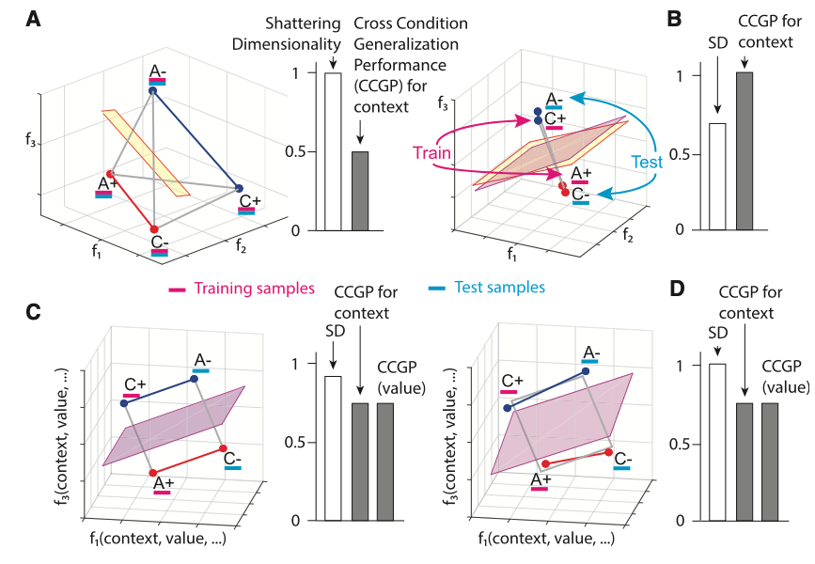
What internal representations are useful for compositional generalization?
Shattering dimensionality versus generalizability/abstraction
High shattering dimensionality –> not ideal for generalizability to new contexts

Slide 4
How are compositional representations in the human brain formatted?
High shattering dimensionality vs. abstract format?
Previous work has shown:
Compositional codes in human prefrontal cortex (Reverberi et al. 2012)
Abstract codes in non-human primate prefrontal cortex and hippocampus (Bernardi et al. 2020)
Little work has focused on:
Geometric format of compositional codes in humans and their importance
Our objective:
We characterize the geometric format of compositional codes in humans
Demonstrate their utility for compositional generalization in ANNs

Slide 5
Main questions
Do humans represent task information abstractly?
What are the benefits of compositional and abstract representations?
Hypothesis: Compositional behaviors benefit from abstract and generalizable representations in both humans and ANNs
Specific approach:
Characterize the geometric format (degree of abstractedness) in human fMRI data during a compositional task
Identify whether or not these ‘abstract formats’ emerge when an ANN is forced to learn compositionally
Characterize (and illustrate) the computational benefits of these abstract representations in models

Slide 6
General outline of results
Empirical human results
Evidence of compositionality in human behavior
Evidence of abstraction and compositional representations in whole-brain human imaging
2. ANN modeling results
Evidence of abstract representations when ANNs are forced to learn compositionally (pretraining on primitive tasks)
Evidence of systematic, zero-shot generalizability with compositional abstraction
3. Current/future work (?)
Optimizing models for compositional, abstracted, and clustered internal representations to facilitate efficient learning and generalizability in compositional tasks

Slide 7
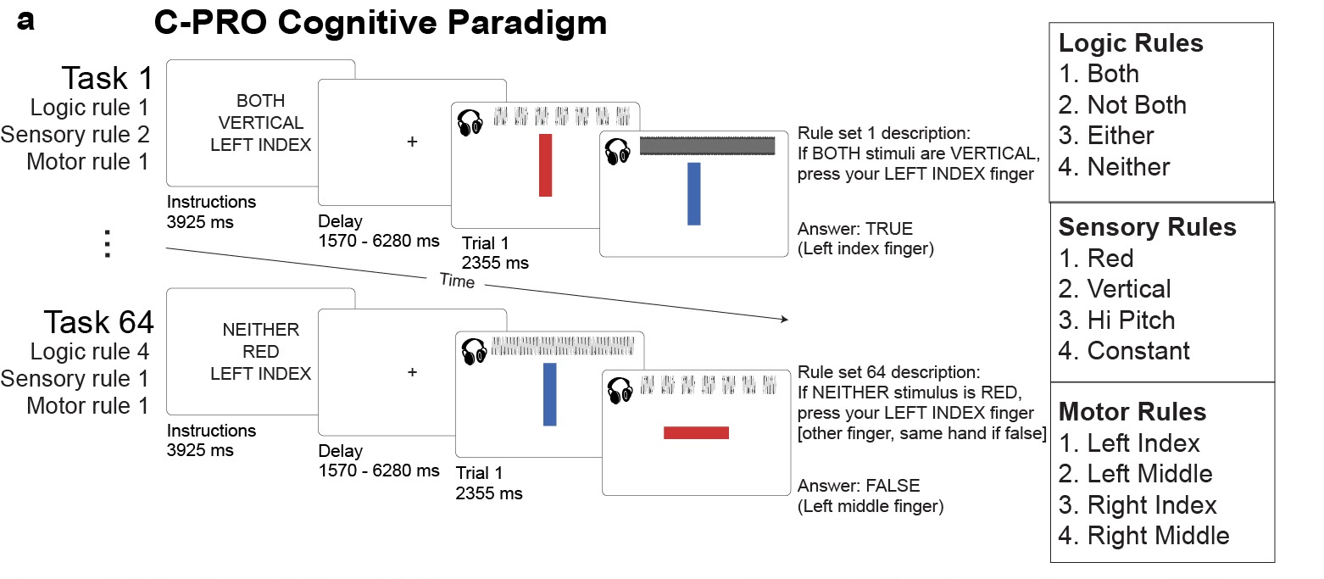
Task – Concrete Permuted Rule Operations (C-PRO)

Slide 8
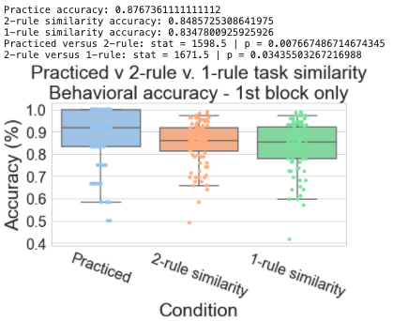
Evidence for compositionality in human behavior
The average performance of all 64 unique tasks (1st trial only)
Practiced tasks had highest performance
Tasks with more overlapping rules with practiced task had marginally higher task performances
Performance reflects likely compositional reasoning in human behavior

Slide 9
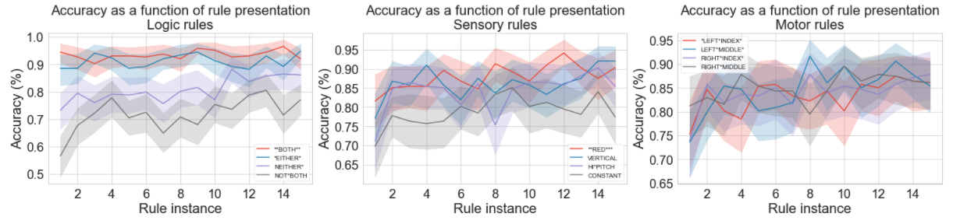
Evidence for compositionality in human behavior
For each rule, we track the performance of new tasks that include previously viewed task rules
Performance increases as a function of task rule viewings (despite being used in a new context), suggesting compositional learning and re-use of task rules

Slide 10
General outline of results
Empirical human results
Evidence of compositionality in human behavior
Evidence of abstraction and compositional representations in whole-brain human imaging
2. ANN modeling results
Evidence of abstract representations when ANNs are forced to learn compositionally (pretraining on primitive tasks)
Evidence of systematic, zero-shot generalizability with compositional abstraction
3. Current/future work (?)
Optimizing models for compositional, abstracted, and clustered internal representations to facilitate efficient learning and generalizability in compositional tasks

Slide 11
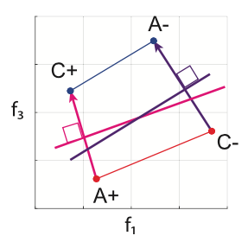
How do we measure abstraction and compositionality in neural data?
Calculating the parallelism score (PS)
If we’re interested in seeing how generalizable a decoder for context (i.e., the blue dots) are, we evaluate the similarity of angles between decoders
So, we can compare the cosine (dot product) between the purple and pink vectors
Bernardi et al. (2020) Cell

Slide 12
Measure abstractedness using parallelism score
BOTH
RED
LMID
BOTH
VERTICAL
RMID
a₂
b₂
A
B
a₁
b₁
EITHER
RED
LMID
EITHER
VERTICAL
RMID
Objective: Compute the angle between A and B, where
A = a₂ – a₁
PS = mean {||A|| • ||B||}
for every possible BOTH v. EITHER combination
B = b₂ – b₁

Slide 13
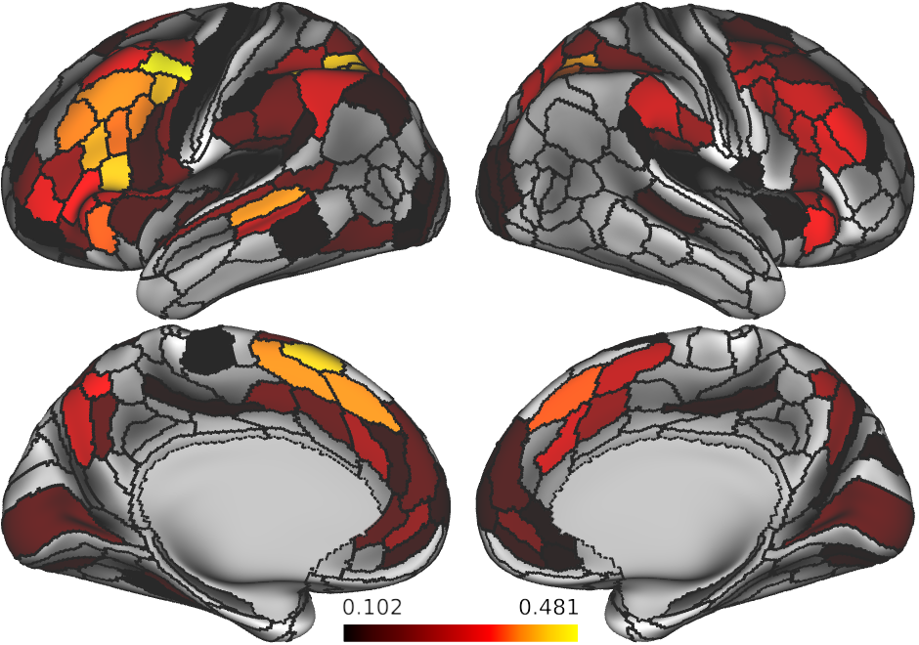
Logic rule parallelism – statistical significance assessed using alpha=0.05 on shuffled data
Abstract representations for logic rules are lie mostly in frontoparietal ”task positive regions”

Slide 14
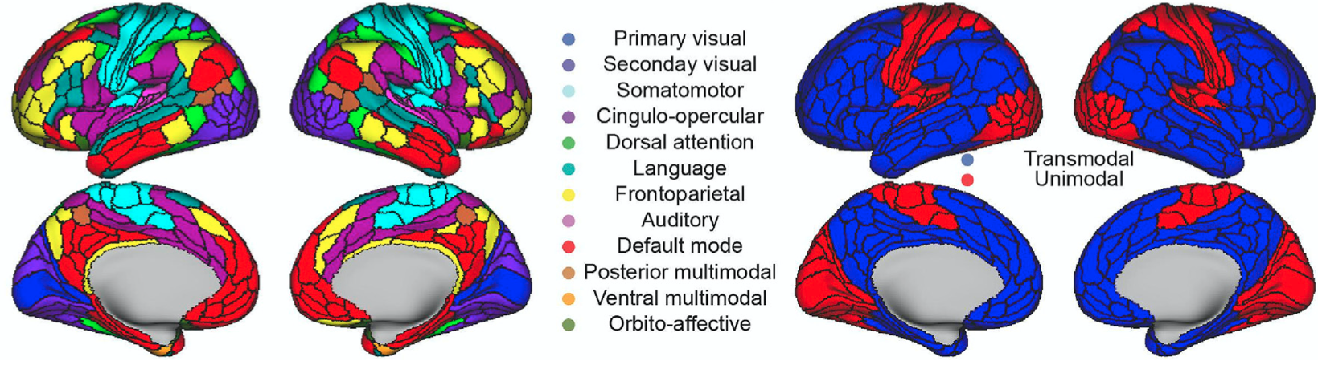
Reference of what functional networks organization in the human brain

Slide 15
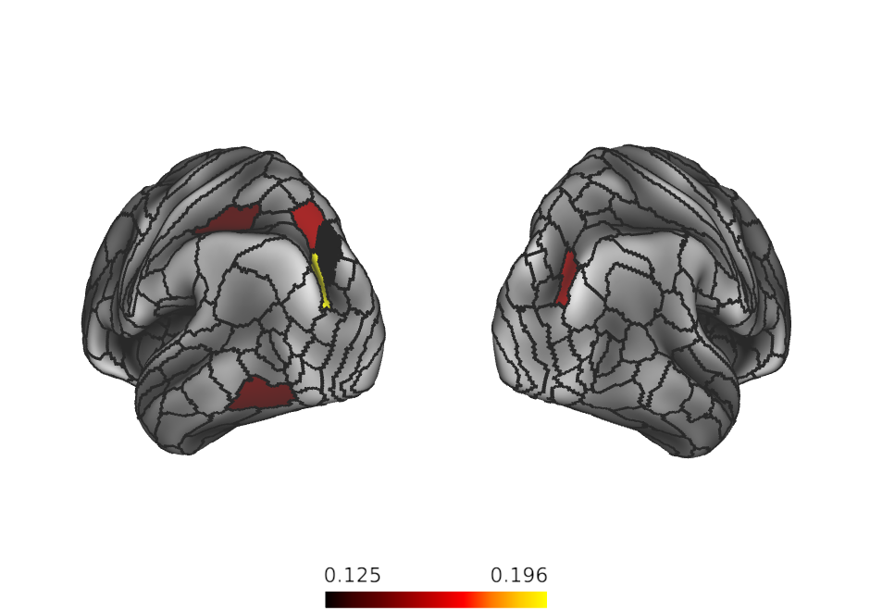
Sensory rule parallelism – statistical significance assessed using alpha<0.05 on shuffled data
Abstract representations for sensory rules are lie mostly in higher order visual areas and some dorsal attention network regions

Slide 16
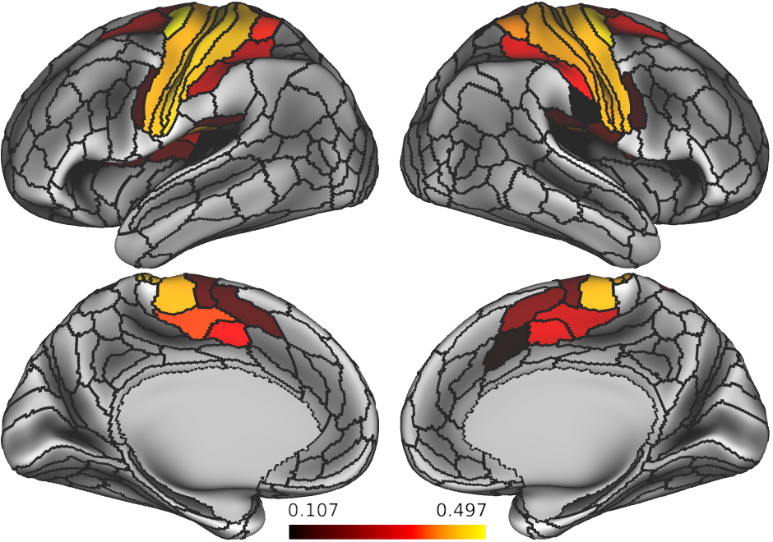
Motor rule parallelism – statistical significance assessed using alpha<0.05 on shuffled data
Abstract representations for motor rules are mostly lie in higher order visual areas and some dorsal attention network regions

Slide 17
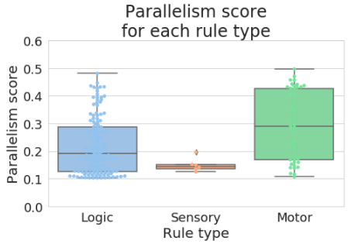
How about the overall degree of parallelism per rule domain?
Sensory rules appears to have an intrinsically lower parallelism score relative to other rule domains
Is this due to the data, or a function of the task?

Slide 18
General outline of results
Empirical human results
Evidence of compositionality in human behavior
Evidence of abstraction and compositional representations in whole-brain human imaging
2. ANN modeling results
Evidence of abstract representations when ANNs are forced to learn compositionally (pretraining on primitive tasks)
Evidence of systematic, zero-shot generalizability with compositional abstraction
3. Current/future work (?)
Optimizing models for compositional, abstracted, and clustered internal representations to facilitate efficient learning and generalizability in compositional tasks

Slide 19
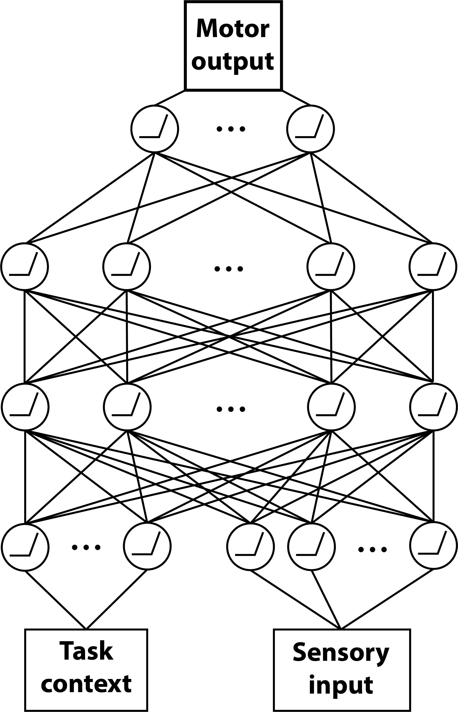
Model architecture – simple feedforward network
4 units
256 units
256 units
11 (context) + 16 (sensory) units

Slide 20
Analysis 1 – Force an ANN to learn compositionally through training on primitive tasks
Build a model to perform the C-PRO task
Evaluate compositional behavior on a network trained on 4 tasks with pretraining (on compositional primitives) and without
Does the ANN exhibit similar compositional behaviors to humans?

Slide 21
Analysis 1 – ANN pretraining approach
Two simplified tasks:
Sensorimotor task:
If RED press LEFT MIDDLE
If VERTICAL press RIGHT INDEX
Logical-sensory tasks
If BOTH RED -> TRUE/FALSE
If NEITHER VERTICAL -> TRUE/FALSE
For both networks: Train on 4 practiced tasks (like human experiment)

Slide 22
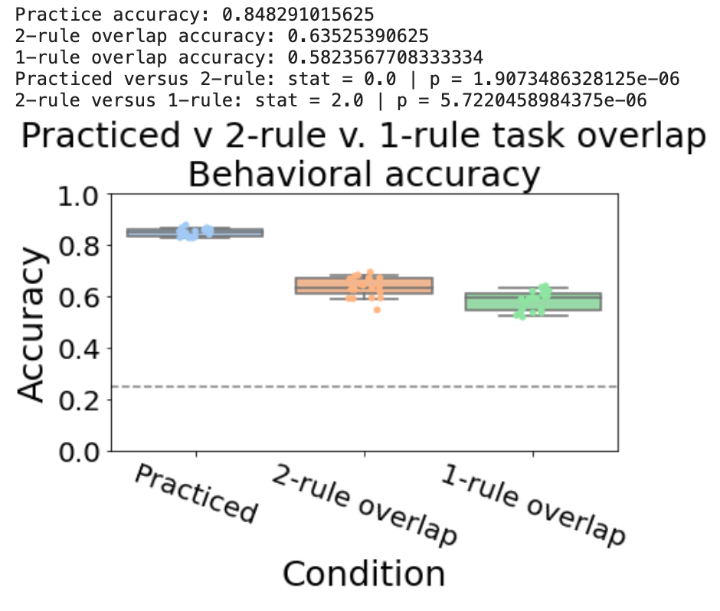
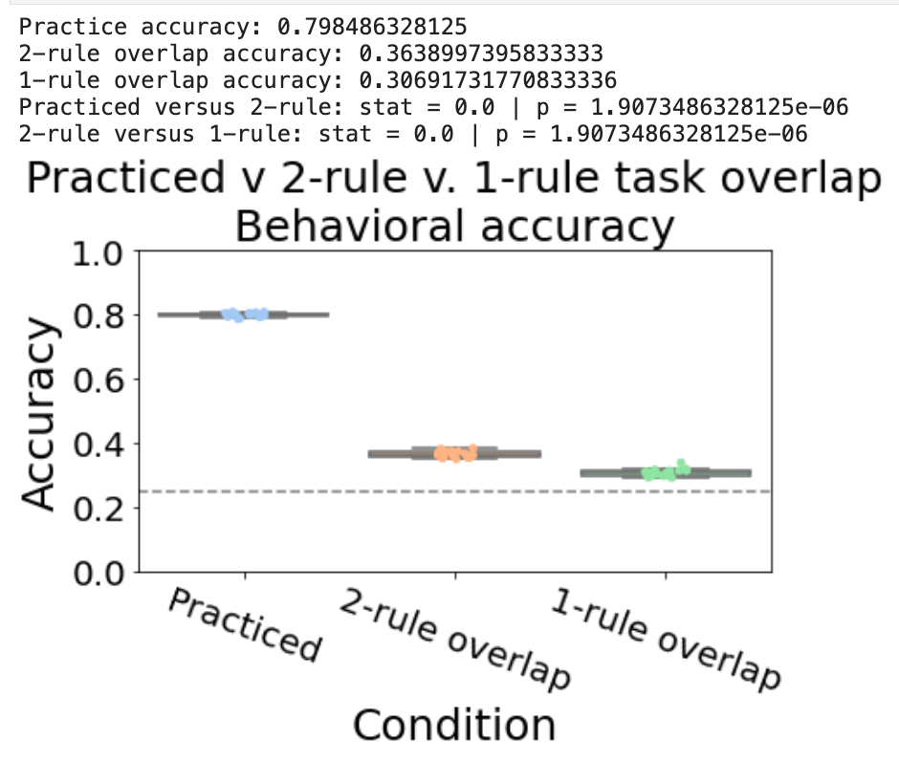
Accuracy significantly improves with pretraining on primitive tasks

Slide 23
Networks without pretraining cannot generalize and learn new tasks

Slide 24
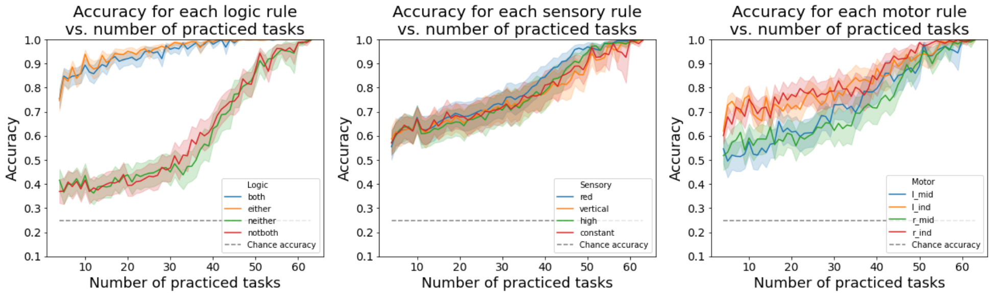
ANN equivalent of by-rule analysis – Adam x pretraining
“both” and ”either” are significantly easier than ”notboth” and “neither”

Slide 25
Why are ANNs biased towards affirmative (BOTH & EITHER) rules, rather than negative rules?
Hypothesis – Questions that we pose are inherently biased towards affirmative conditionals
Ex: If RED then press RMID
Observation: Questions can be inherently biased towards negative conditionals, too
Ex: If NOT RED, then press RMID
Hypothesis: Train network only on negative conditionals in the sensorimotor primitive task

Slide 26
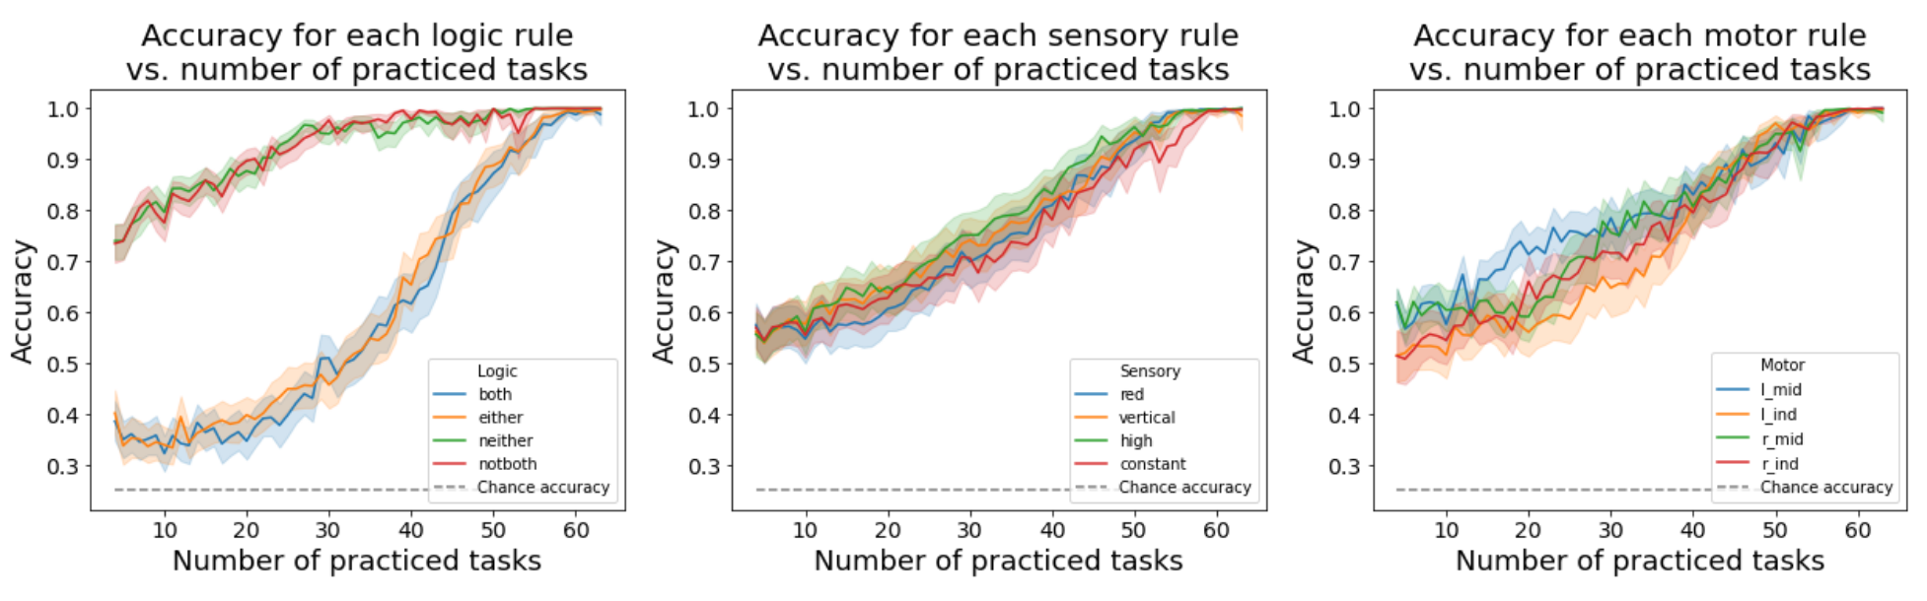
Training on negations only
Performance on specific logical rules is flipped – rules involving negations outperform ‘affirmative’ rules

Slide 27
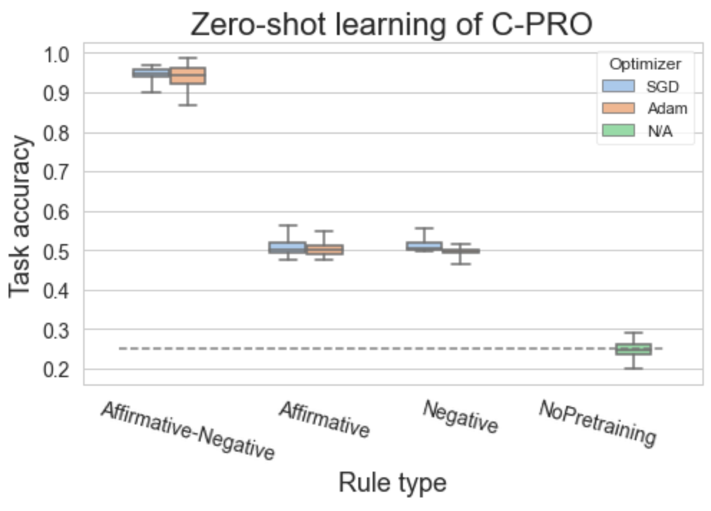
Training on negations and affirmative tasks equally
Equal training on both affirmative and negative versions of the primitive task enable zero-shot learning
Illustrates systematicity (ability to re-use rules)
Productivity (though only of depth 1)

Slide 28
ANNs exhibit compositional behavior when trained in a compositional way
Next: ANN representations

Slide 29
Parallelism as a function of # tasks trained
Higher parallelism -> higher the abstraction
Pretraining boosts parallelism

Slide 30
Parallelism by rule type
PS from empirical brain data
Gray distribution is the “null”
Domain specific abstraction in ANNs (with compositional training)
mimics abstraction in the brain

Slide 31
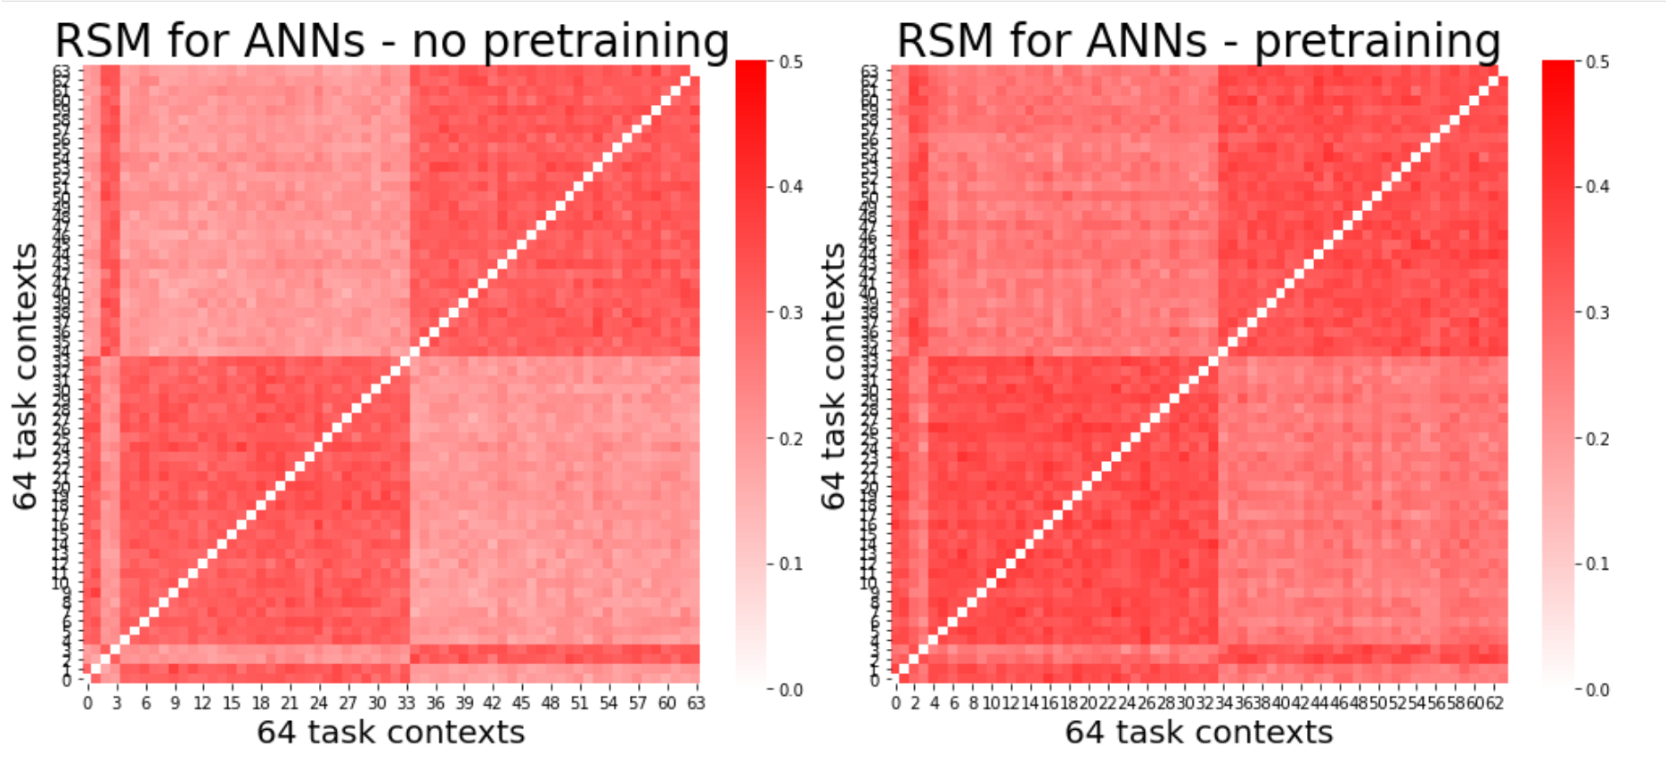
Do pretrained, compositional ANNs have more efficient (lower dimensional) representations?

Slide 32
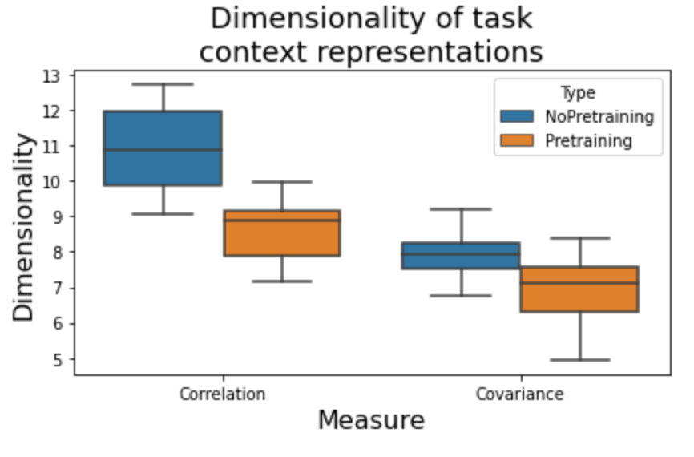
Pretraining of networks also results in reduced dimensionality, another form of abstraction
Dimensionality in the feature space

Slide 33
Summary of results
Humans exhibit compositionality in task performance between familiar and novel task types
Humans exhibit compositional brain representations as exhibited by parallelism scores across rule types
ANNs can exhibit compositionality, if pretrained with useful compositional primitives
This affords generalizability as evidenced by zero-shot learning
Abstract and efficient representations may underlie the ability to generalize in both humans and ANNs

Slide 34
Applications to AI (yet to be done)
Can we regularize task performance using different measures of abstraction?
Maximize parallelism in hidden units
Minimize dimensionality in hidden units

Slide 35
How are the task rule inputs modeled?
both
either
not
red
vertical
high
constant
lmid
lind
rmid
rind
Logic
Sensory
Motor

Slide 36
How are simple/primitive tasks modeled? Logical-sensory primitive task
both
either
not
red
vertical
high
constant
lmid
lind
rmid
rind
Logic
Sensory
Motor
If EITHER stimulus is VERTICAL, output TRUE; else FALSE
both
either
not
red
vertical
high
constant
lmid
lind
rmid
rind
Logic
Sensory
Motor
If NEITHER stimulus is HIGH, output TRUE; else FALSE

Slide 37
How are simple/primitive tasks modeled? Sensorimotor primitive task
both
either
not
red
vertical
high
constant
lmid
lind
rmid
rind
Logic
Sensory
Motor
If stimulus is VERTICAL, output RMID; else RIND
both
either
not
red
vertical
high
constant
lmid
lind
rmid
rind
Logic
Sensory
Motor
If stimulus is HIGH, output RIND; else RMID

Slide 38
Why are ANNs biased towards affirmative (BOTH & EITHER) rules, rather than negative rules?
Hypothesis – Questions that we pose are inherently biased towards affirmative conditionals
Ex: If RED then press RMID
Observation: Questions can be inherently biased towards negative conditionals, too
Ex: If NOT RED, then press RMID
Hypothesis: Train network only on negative conditionals in the sensorimotor primitive task

Slide 39
Converting affirmative conditionals to negative conditionals in the sensorimotor primitive task
both
either
not
red
vertical
high
constant
lmid
lind
rmid
rind
Logic
Sensory
Motor
If stimulus is NOT VERTICAL, output RMID; else RIND
both
either
not
red
vertical
high
constant
lmid
lind
rmid
rind
Logic
Sensory
Motor
If stimulus is NOT HIGH, output RIND; else RMID

